Slide 1
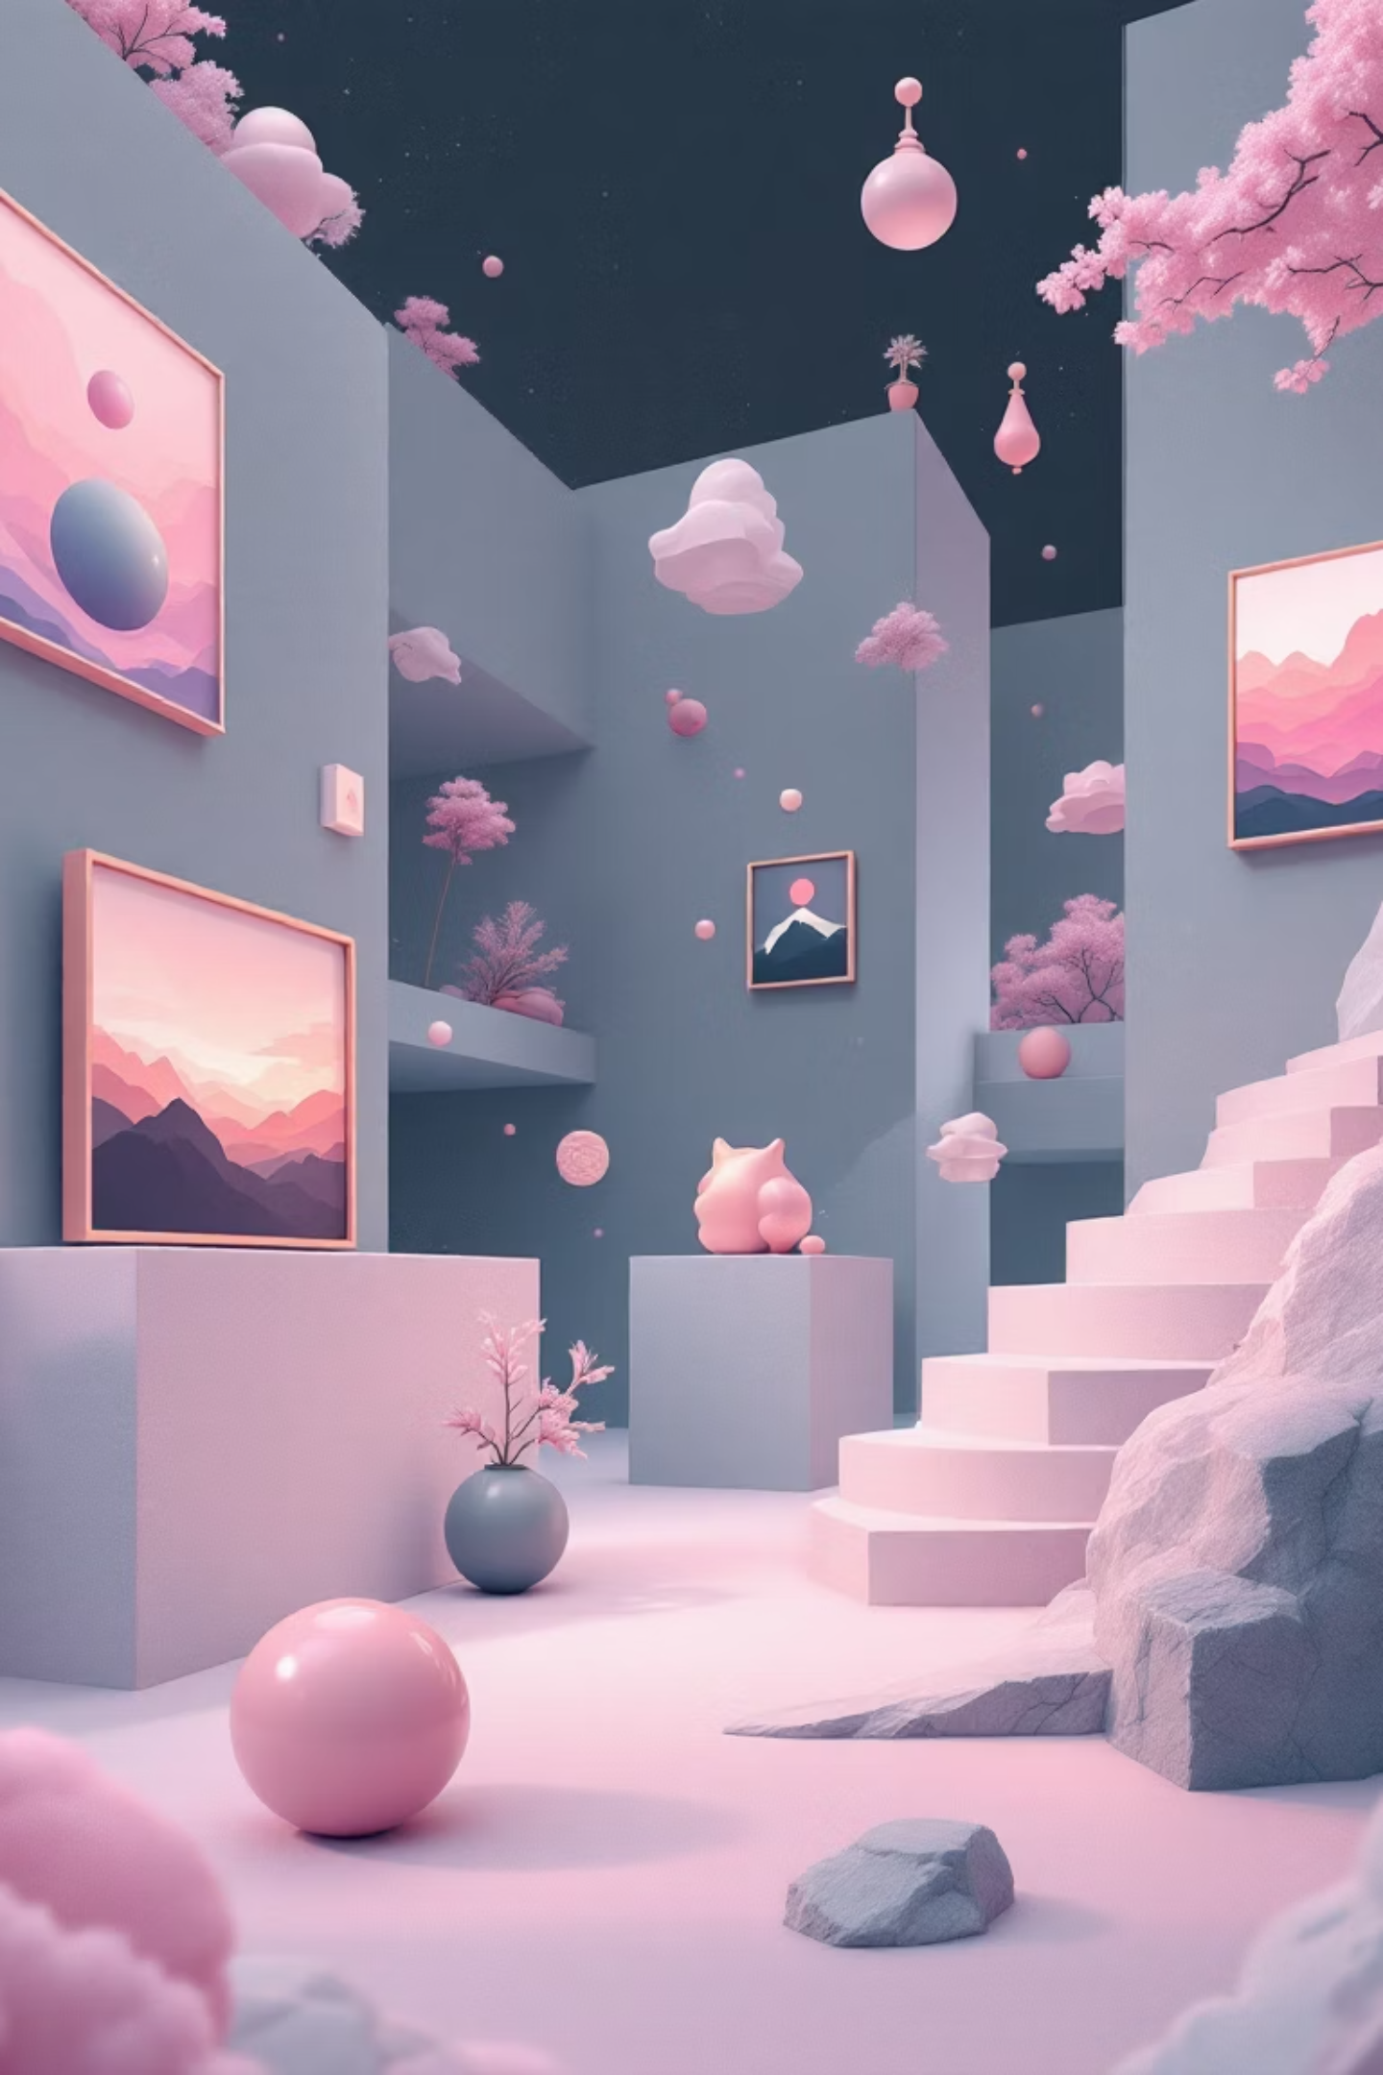
AR Art Gallery Utility
Design a Virtual AR Gallery to Display 3D Paintings or Sculptures
Subject: ARDA | Team Members: Siddharth Singh (AIA-4), Devansh Singh (AIA-4), Aditya Takale (AIA-4), Shrikunj Rathi (AIA-1)

Slide 2
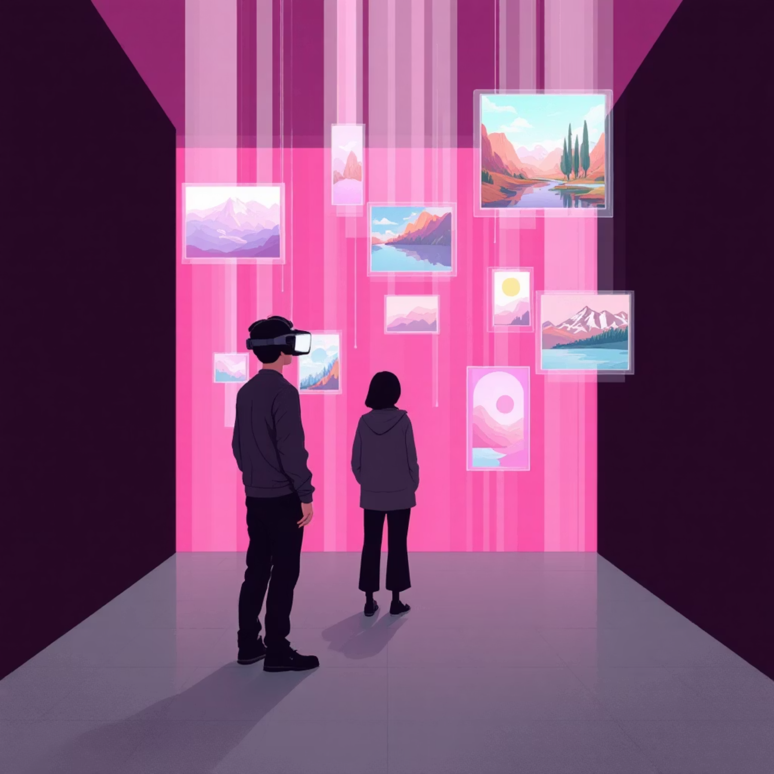
Project Overview
What is AR?
Augmented Reality (AR) merges digital content with the physical world, creating interactive experiences that enhance how we perceive and engage with our environment.
Our Vision
A revolutionary virtual art gallery where users can explore 3D paintings and sculptures anywhere, transforming how we experience and interact with art in the digital age.
Purpose: Making art interactive, immersive, and accessible to everyone, breaking down traditional barriers of physical galleries.

Slide 3
Problem Statement & Objectives
Limited Space
Geographic Barriers
Time Constraints
Physical galleries constrain the number of artworks that can be displayed, limiting artistic expression and visitor experience.
Art enthusiasts must travel to specific locations, creating accessibility challenges for global audiences.
Operating hours and exhibition schedules restrict when people can experience art collections.
Our Objective
Create an immersive AR environment that eliminates physical limitations, allowing users to explore curated digital art collections from anywhere, at any time, with unprecedented interactivity and engagement.

Slide 4

Tools & Technologies
Unity
Blender
Primary development platform for building the AR gallery environment, providing robust 3D rendering and cross-platform deployment capabilities.
Professional 3D modeling suite used to create detailed sculptures and paintings, optimizing assets for real-time AR performance.
AR SDKs
C# Programming
Vuforia, ARCore, and ARKit for device tracking, spatial mapping, and seamless AR integration across iOS and Android platforms.
Scripting language for Unity, handling user interactions, gallery navigation, and dynamic content loading systems.

Slide 5
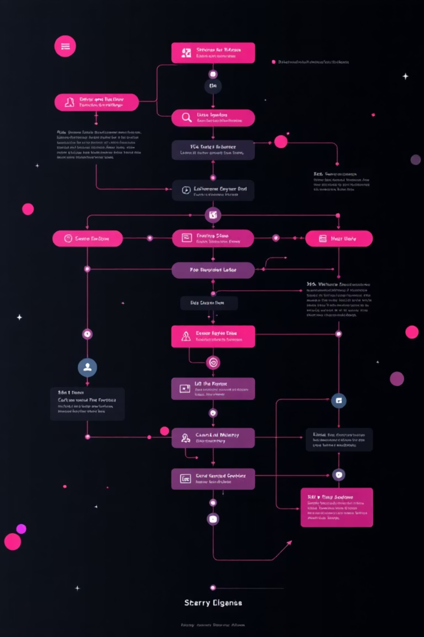




System Workflow
Concept & Design
Defining gallery layout, user experience flows, and artistic curation strategies.
3D Modeling
Creating high-fidelity 3D paintings and sculptures with optimized polygon counts and textures.
AR Integration
Implementing AR tracking, spatial anchors, and testing across multiple devices and environments.
Deployment
Publishing to app stores, gathering user feedback, and iterating on performance.

Slide 6

Key Features
3D Artwork Display
High-resolution paintings and sculptures rendered in real-time AR with accurate color reproduction and depth perception.
Interactive Controls
Intuitive gestures for zooming, rotating, and repositioning artworks to examine every detail from any angle.
Contextual Information
Tap any artwork to reveal artist bios, historical context, technique descriptions, and curatorial notes.
Realistic Rendering
Advanced lighting systems, PBR materials, and shadow casting create photorealistic art presentations.

Slide 7
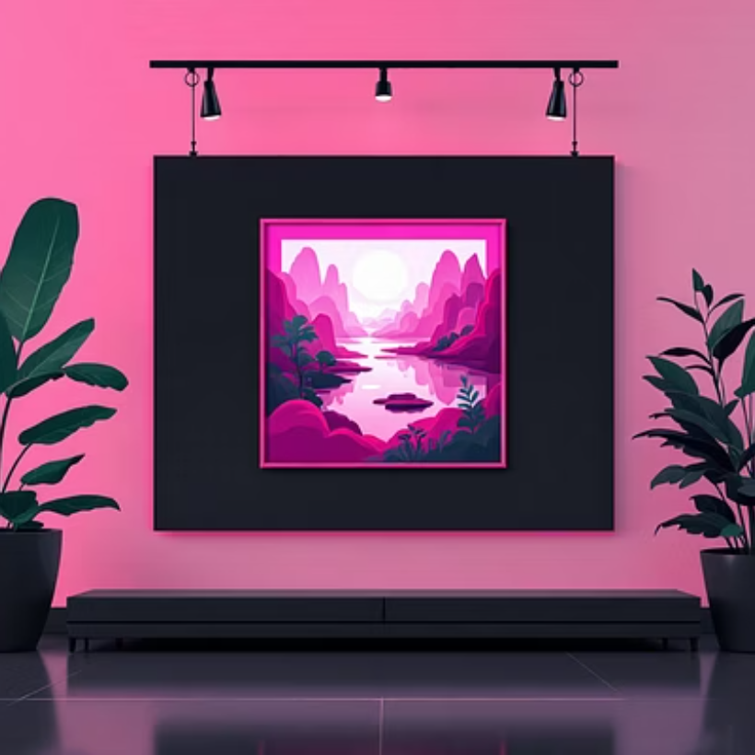
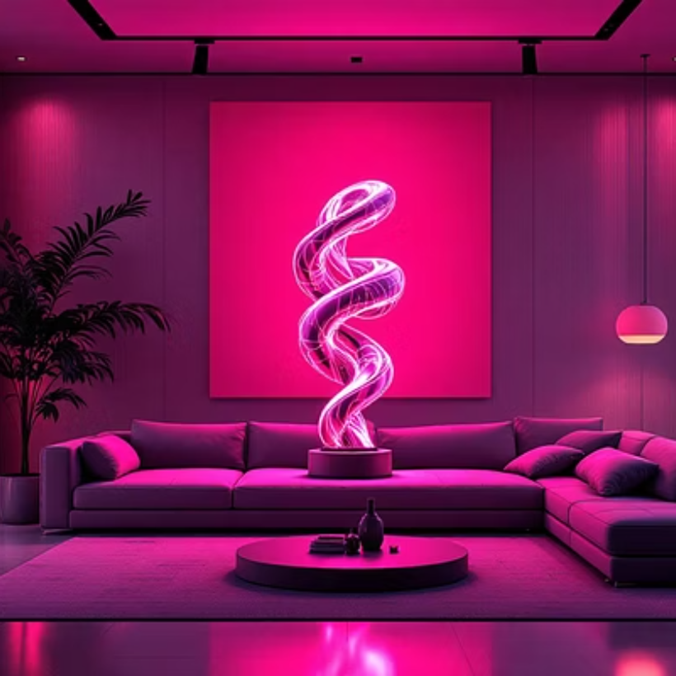
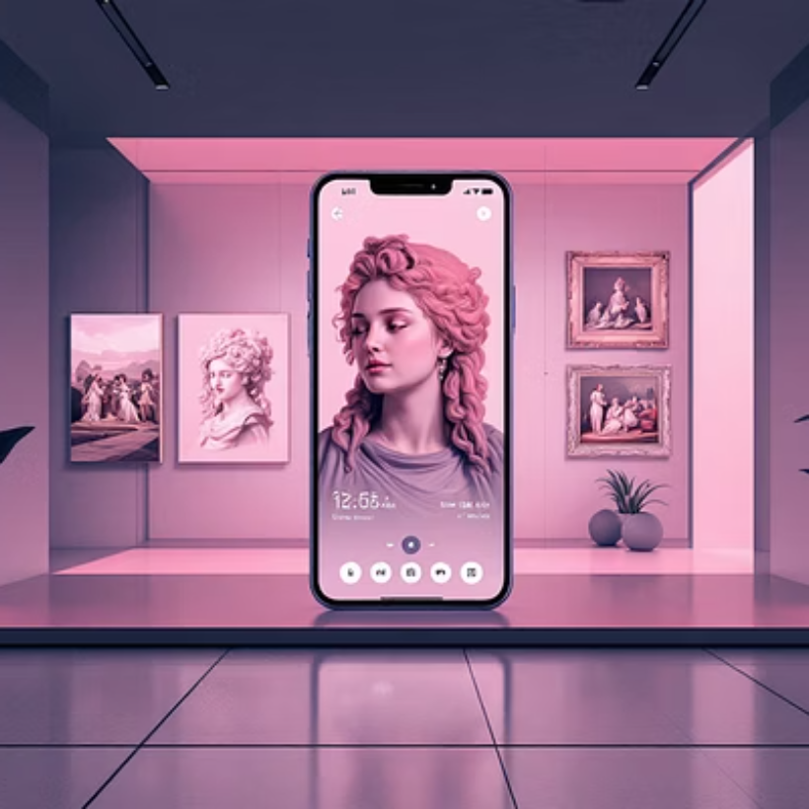
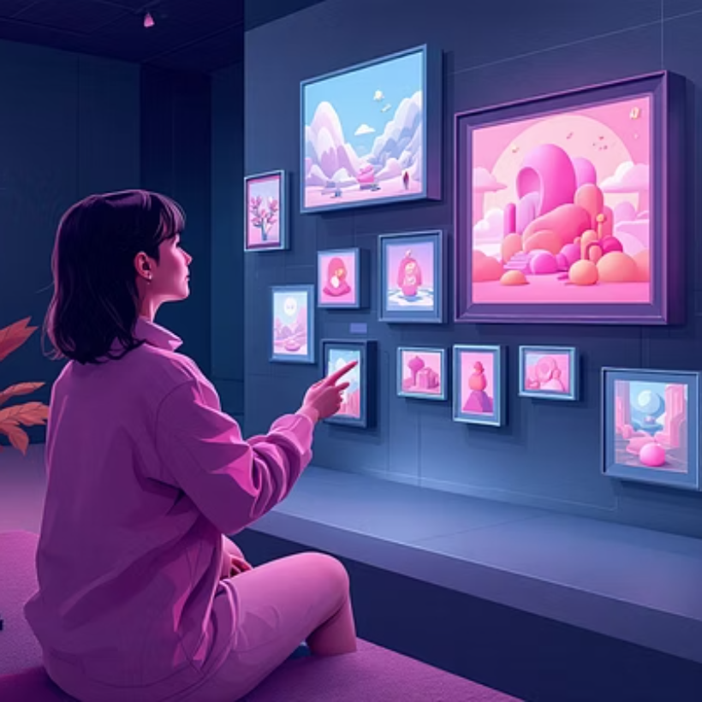
Implementation Highlights
Our implementation showcases seamless integration of classical and contemporary art in AR environments. Users can place gallery walls anywhere, walk through virtual exhibitions, and experience art at unprecedented scale—from miniature sculptures to monumental installations.

Slide 8
Outcomes & Learnings
Immersive Experience
Enhanced Engagement
Technical Mastery
Successfully created a fully functional AR gallery that transforms any space into a curated art environment.
Users spend 3x more time interacting with AR art compared to traditional digital galleries.
Gained deep expertise in AR development, 3D optimization, spatial computing, and cross-platform deployment.
"This project demonstrated that technology can democratize art access while preserving the emotional impact of experiencing masterpieces in person."

Slide 9
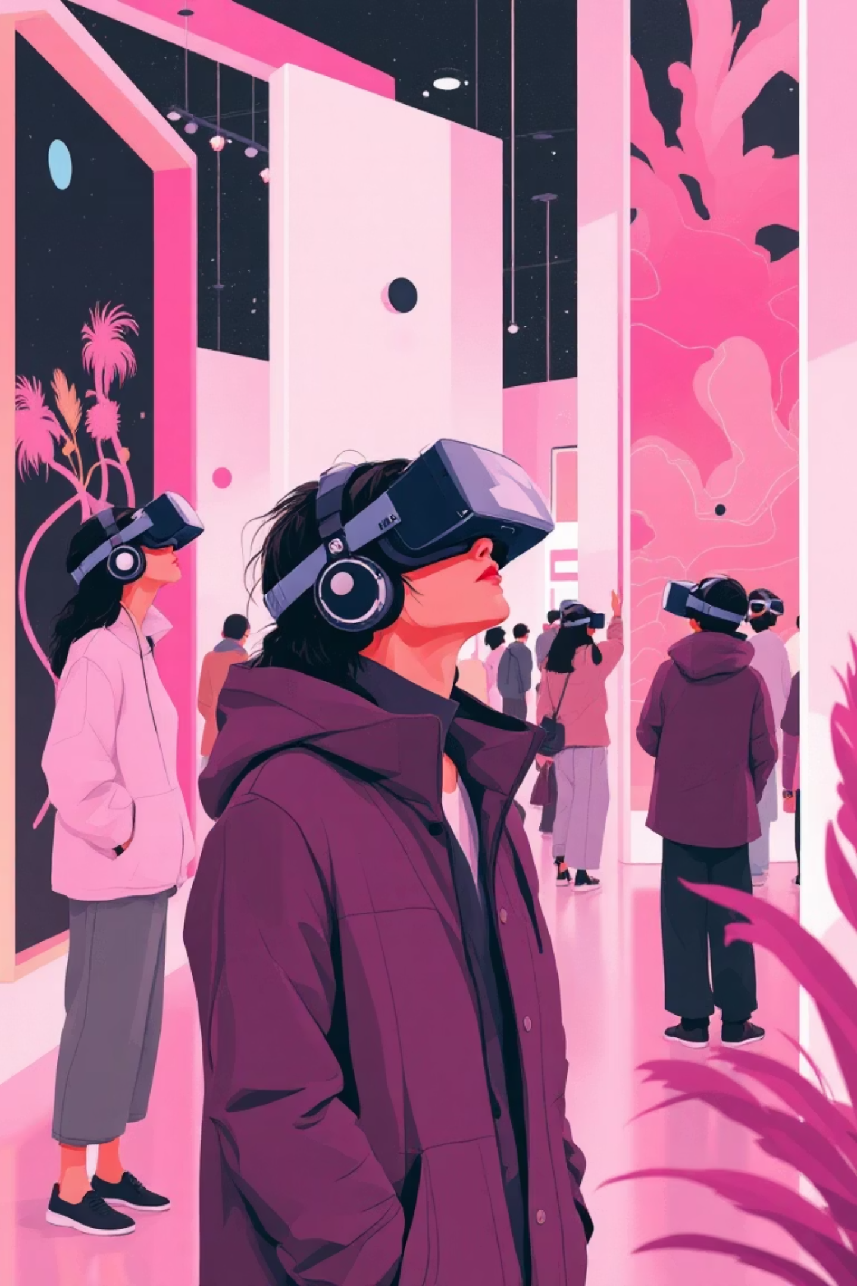
Future Scope
1
VR & Metaverse
Expand to fully immersive VR galleries and integrate with metaverse platforms for persistent virtual exhibitions.
2
AI Curation
Implement machine learning algorithms for personalized art recommendations based on user preferences and viewing patterns.
3
Multi-User Experience
Enable shared AR sessions where multiple users can explore galleries together, discussing art in real-time.
4
Artist Collaboration
Create tools for artists to upload and showcase their own work, building a decentralized digital art ecosystem.

Slide 10
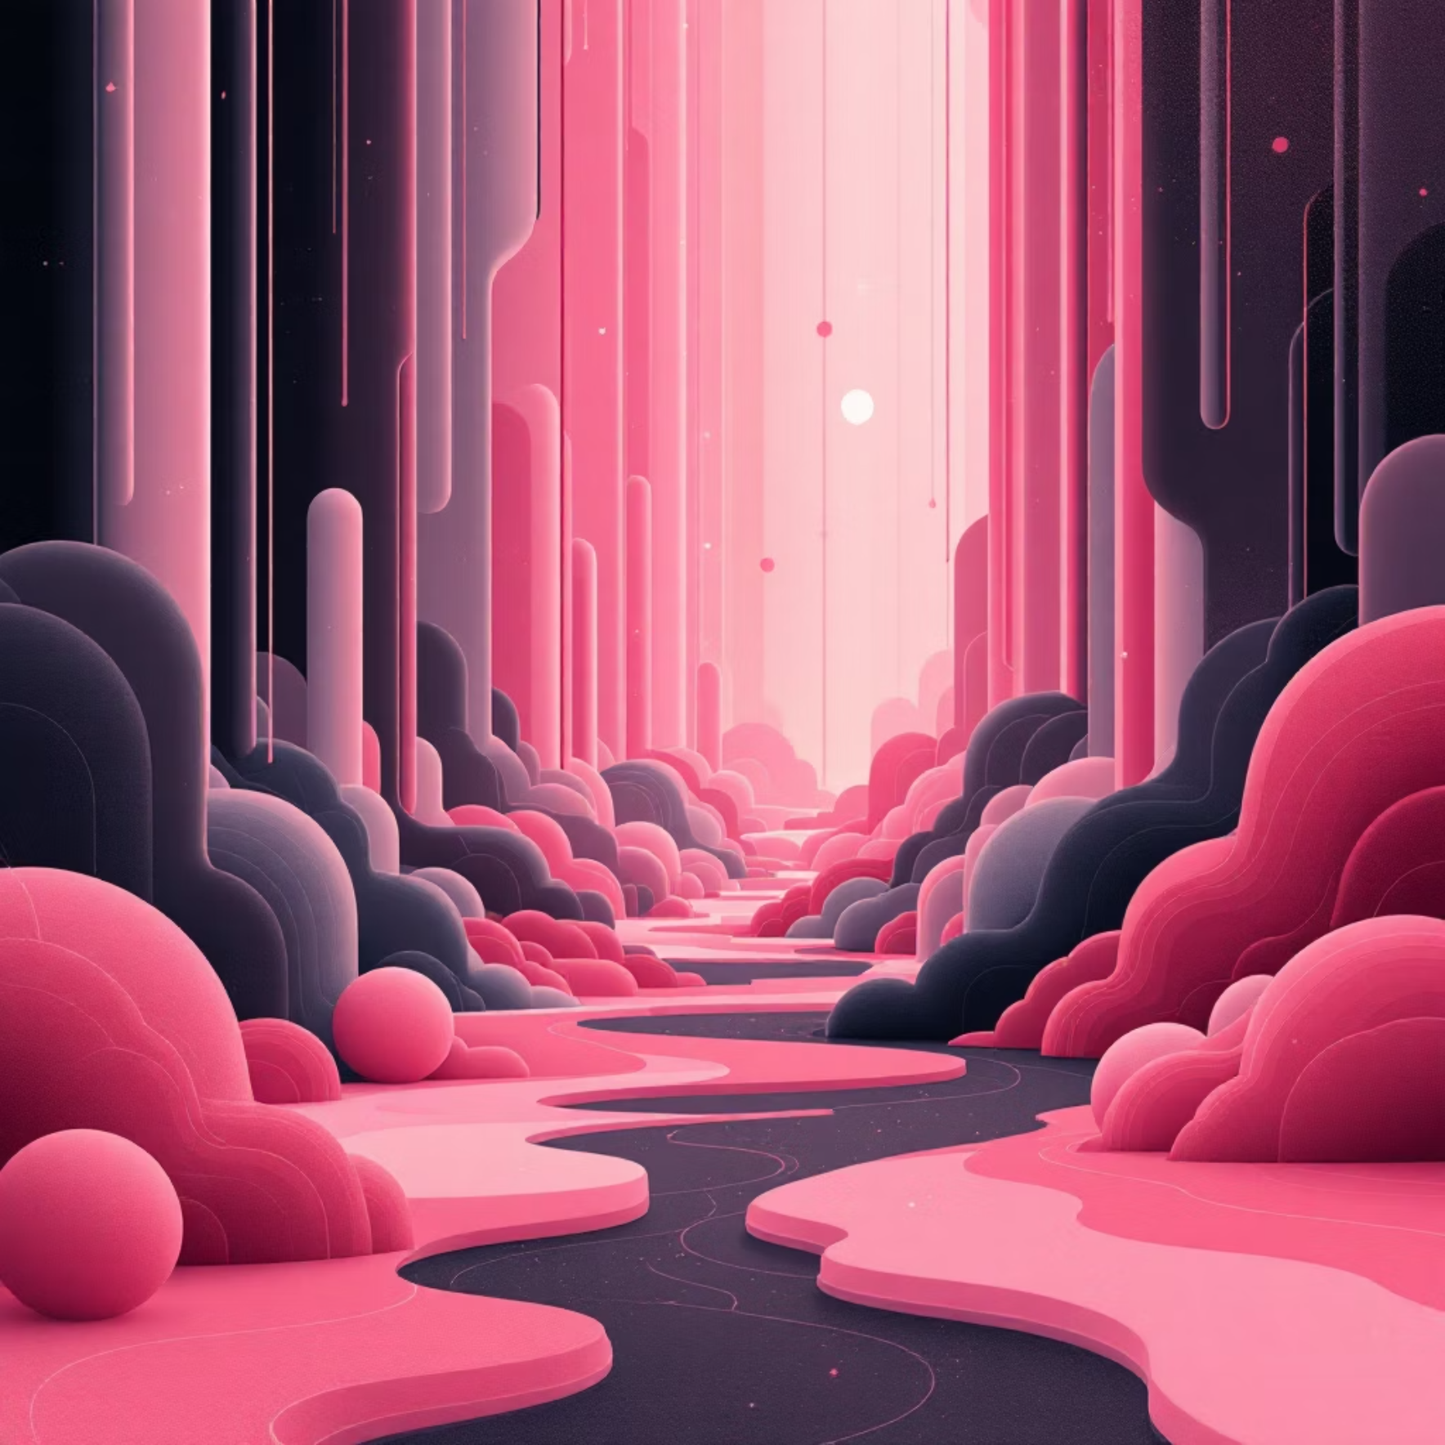
Thank You
Project Summary
We successfully developed an AR Art Gallery Utility that bridges the gap between physical and digital art experiences. Through innovative use of augmented reality, 3D modeling, and intuitive interfaces, we've created a platform that makes art accessible, interactive, and engaging for everyone.
Team Members
Siddharth Singh (AIA-4)
Devansh Singh (AIA-4)
Aditya Takale (AIA-4)
Shrikunj Rathi (AIA-1)
Questions and feedback are welcome

